Slide 1





Library DBMS CLI Presenters
Hadeel Alnumiri
Milad Torang
Hojjatollah Saeedi
Nasir Ahmad Dastgirzada

Slide 2


Agenda
Introduction
Features Overview
Demonstration
Conclusion
ERD Diagram-implementation

Slide 3

Introduction
The Library CLI Application revolutionizes library management by providing a streamlined solution through text-based commands.

Slide 4
Features Overview
Here's a step-by-step walkthrough of user interactions in the CLI Application:
Start: Launching the Library CLI.
sign_up: Sign up a new user.
delete_user: Delete a user from the database.
sign_in: Sign in a user.
search_by_name: Search for books by name.
search_by_author: Search for books by author.
most_read_books: Display the 10 most-read books.
recently_added: Display the 5 most recent books added.
most_read_genres: Display the 5 most-read genres.
most_read_authors: Display the 3 most-read authors.
add_book: Add a book to the database.
delete_book: Delete a book from the database.
borrow_book: Borrow a book from the library.
return_book: Return a borrowed book to the library.
mark_read: Mark a book as read.
fav_book: Add a book to favorites.
my_books: View user's books.
statistics: View user's reading statistics.

Slide 5
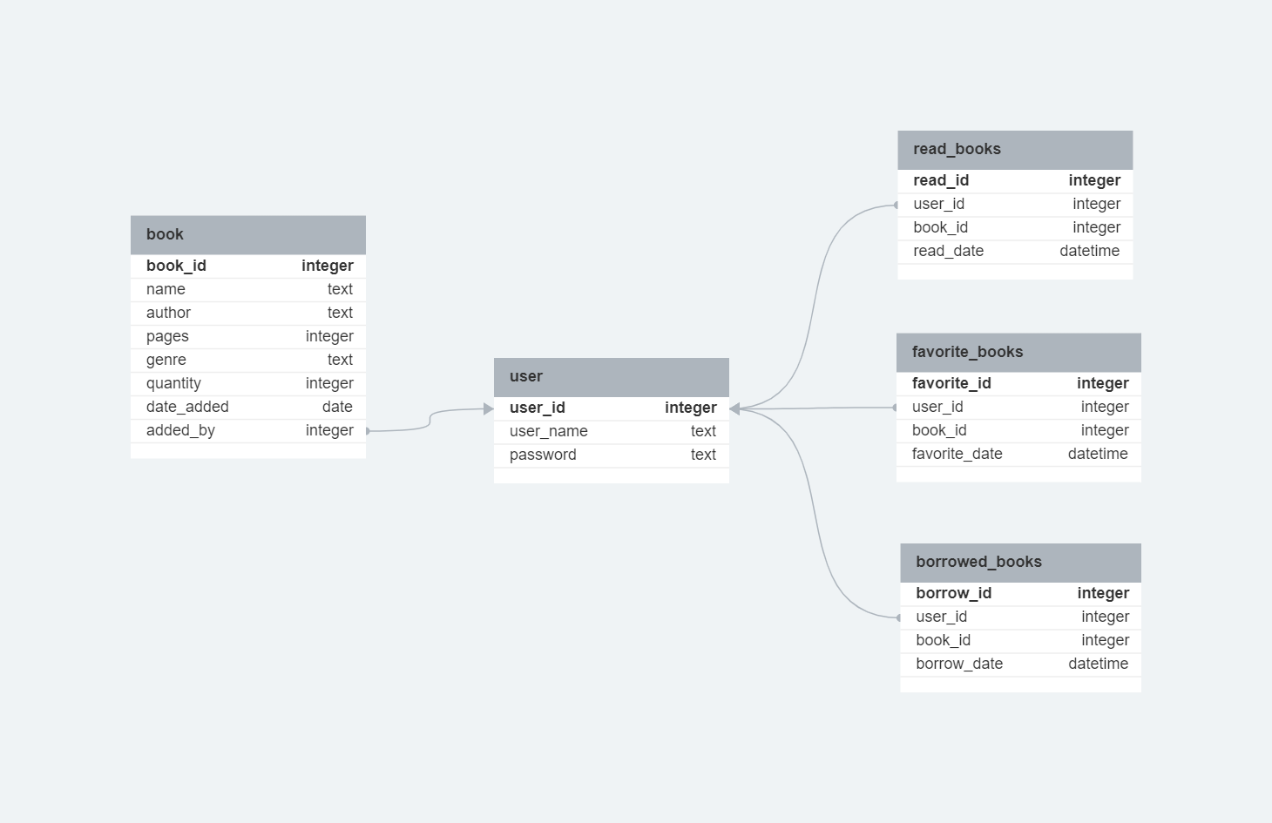
ERD diagram - implementation

Slide 6

Demonstration
Sign Up Function
Input Parameters
The function requires 'username' and 'password' as input parameters to create a new user account.
Add book Function
Input Parameters
The function requires book_id' and username' for borrowing a book from the library.
Borrow book Function
Input Parameters
The function requires book name, author, pages, genre, to allows users to add a new book to the database.
Error Handling
In case of any errors, appropriate error messages are returned to the user

Slide 7
Conclusion
Enhances library management.
Improves efficiency and accuracy.
Centralizes data and scales well.
Cost-effective.
Promotes user productivity.

Slide 8


THANK YOU
Hadeel Alnumiri
Milad Torang
Hojjat Ollah Saeedi
Nasir Ahmad Dastgirzada

